Slide 1
David Steele, PhD
Resource Teacher for the Gifted
Gunston Middle School
Notes:
Add your name
Add school name

Slide 2
Before we start
On each table you will find index cards that can be used to jot down any questions during the presentation.
If I did not address your question during the presentation, please include your name, your child’s name (if applicable), your contact information, and the best time for me to reach you.
Notes:
Put index cards and pen/pencils on each table

Slide 3
Objectives
Explain the role of the Resource Teacher for the Gifted (RTG) within a Professional Learning Community (PLC).
Provide an overview of gifted services at add your school
Provide an overview of the identification process for Gifted Services in Arlington Public Schools.
Notes:
Add school name

Slide 4
THE NAGC recommends that every school provide:
Notes:
APS model for gifted services is in alignment with recommendations for the National Association for Gifted Services

Slide 5
THE NAGC recommends that every school provide:
access to curricular resources designed for gifted learners
systematic and substantial professional development for all teachers
needs of gifted learners
differentiation in general
flexible grouping approaches
resource specialists who can support the classroom teacher
in assessing gifted learner differences
making adjustments to the curriculum
and implementing advanced curriculum and strategies
Notes:
NAGC recommendations – I would give them a minute to read this slide

Slide 6
Virginia Gifted Regulations – APS Local Plan 2017 - 2021
Virginia Department of Education regulations state that each school district must develop a plan to identify and provide services to those students who have learning needs beyond the regular instructional program.
https://www.apsva.us/wp-content/uploads/2015/04/2017-2022-Gifted-Services-Local-Plan.pdf
Notes:
There is a state regulation to identify and provide services to students

Slide 7
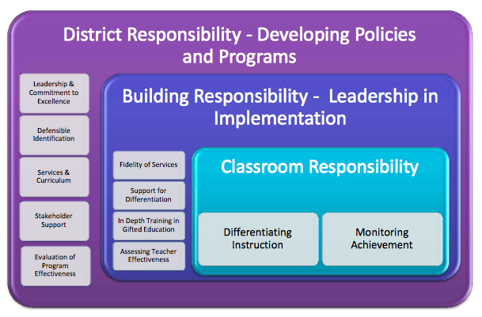
Shared Responsibility for Daily Differentiation for Gifted Learners
Cluster Teacher
Collaboration with RTG
Curriculum for Gifted Learners
Notes:
Bigger picture view of services – SHARED responsibility for serving gifted students
Sometimes visuals help people see the vision and am also hoping this will help people see that you are working within a system building capacity
Here is more background for you if you would like it
Responsibilities for educating gifted children fall into three levels of administration and decision making: District Administrator Responsibilities Include:
• Aligning the philosophy, goals, and commitment for the development of students with advanced potential with district goals for the development of all students.
• Creating flexible policies regarding student placement to meet the needs of individual students
• Requiring specified training for teachers who have responsibility for students with advanced potential.
• Ensuring that curriculum for gifted students is mapped and articulated K-12 for systematic development of their academic potential
• Organizing services, programs, classes, personnel, and student placements to facilitate the delivery of advanced and differentiated
curriculum.
• Designing and implementing a multifaceted identification plan that includes measures that are valid and reliable and that will find those
students with outstanding performance and those with potential for outstanding performance from all cultural groups.
• Involving the stakeholders in the planning of services, in communicating about the program, and designing the evaluation of
effectiveness of those services.
Building Administrator Responsibilities Include:
Aligning the implementation of student services with the district design
Facilitating delivery of services for students, such as scheduling classes to facilitate differentiation of student instruction through grouping and collaboration Providing leadership in analysis of student achievement data Providing in-depth training opportunities in gifted education to maximize both teacher and student performance.
Addressing parental concerns for the appropriate academic challenge for individual students.
Classroom Teacher Responsibilities Include:
• Using the developed curriculum and differentiating instruction with students with advanced potential
• Monitoring the achievement of students with advanced potential
• Educating oneself on the unique social, emotional, and cognitive needs of gifted students
From An Introduction to Gifted Education: The Complete Kit for Facilitators, Coordinators and In-Service Training Professionals by Kristie Speirs Neumeister, Ph.D. klspeirsneum@bsu.edu and Virginia H. Burney, Ph.D. vhburney@bsu.edu Waco, TX: Prufrock Press. Reprinted with permission from Prufrock Press.

Slide 8
Part 1: Professional Learning Communities

Slide 9
Professional Learning Communities
Four Key Questions Focus Us on Learning
What is it we expect our students to learn?
How will we know when they have learned it?
How will we provide time and support when they don’t learn it?
How will we extend learning when they already know it or learn it quickly?
Notes:
PLCs are the umbrella structure for the school system -- APS has a collaborative approach to meeting the needs of students
Collaborative Learning Teams (CLTs or CTs) are within each school to do this strategically. They use a variety of data points throughout the year and these questions to plan for instruction
Our focus is question #4

Slide 10
My roles within a PLC
The primary role of the RTG is to increase teachers’ capacity to infuse gifted pedagogy into the general education classroom.
This capacity includes the ability to implement curriculum designed for high-ability learners
Notes:
Question #4 of PLC: How will we extend learning when they already know it or learn it quickly?
This is my area of focus. This support happens in a variety of ways: within CLTs, planning individual with teachers, leading professional development, modeling and/or co-teaching curriculum written for advanced learners and critical and creative thinking lessons

Slide 11
Role of the RTG
Promote and model procedures, strategies, and techniques to support gifted students
Work collaboratively with cluster teachers to plan and deliver instruction
Provide curricular resources in order to differentiate content for gifted students
Lead PD and/or inform staff about gifted education training opportunities
Advocate for underrepresented populations to include 2e, ESOL/HILT, children from poverty
Facilitate the gifted identification process
APS Local Plan for the Gifted 2012-2017
Notes:
Here is a big picture version of my role and support I give within the building

Slide 12
Gifted Services in 6-8 classrooms
Collaborative Cluster Model
Cluster Teacher is primary deliverer of differentiation with support from RTG

Slide 13
Classroom Support (Grades 6-8)
Collaborate with grade-level teams to plan and/or implement advanced content
Socratic seminar
Utilize collaborative teaching methods to provide support for differentiating instruction
Experimental design
Working with teachers to find and nurture underrepresented populations
Working with Minority Achievement Coordinator
Focus on 2 X10

Slide 14
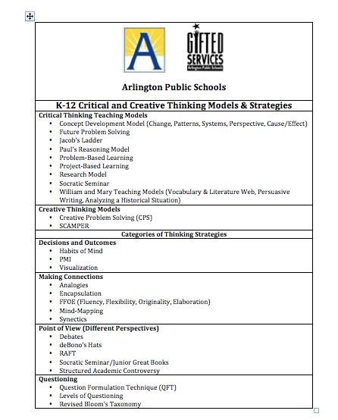
Notes:
Here is our Critical and Creative Thinking framework. RTGs model/plan/co-teach lessons using these strategies to raise the level of rigor in the classroom for gifted as well as to expose all learners to challenging and engaging lessons. Once these are modeled for the teacher, the teacher infuses these strategies in daily lessons when appropriate. The RTG works with the collaborative teams to support this implementation.

Slide 15
Advanced-Content Resources
William and Mary Literature Units
Socratic Seminar
Jacob’s Ladder Reading Comprehension Program
Schoolwide Enrichment Model-Reading (SEM-R) Framework
Best of the Continental Math League
Experimental Design
William and Mary Problem-Based Science Units
William and Mary Social Studies Units
History Alive!
The DBQ Project
Primary Source Documents (Library of Congress)
Notes:
Here is a list of some of the advanced content curriculum you may see in your child’s classroom. Cluster teachers take this training and implement with cluster group (and in other students who demonstrate they are ready for this challenge) with support from RTG

Slide 16
Science

Slide 17
Collaborative Teaching
Collaborative Teaching may involve:
Whole group team teaching with classroom teacher
Small group teaching in classroom, coordinated and co-planned with classroom teacher
Co-planning with classroom teacher to support differentiation on days when gifted resource teacher is not in the classroom
Flexible grouping, which may be determined by
Needs of students and/or the classroom teacher
Difficulty of unit/topic
Notes:
Many parents asks how this collaboration with the cluster teacher happens or what does it look like? Here are a few ways that this collaboration happens.
If you have different examples for how you have worked with teachers in these different ways, you may want to share that to illustrate the point better.
The point is it will look different depending on the teacher’s background and expertise, your background and expertise and the needs of the students

Slide 18
Examples of What Collaboration Might Look Like …

Slide 19
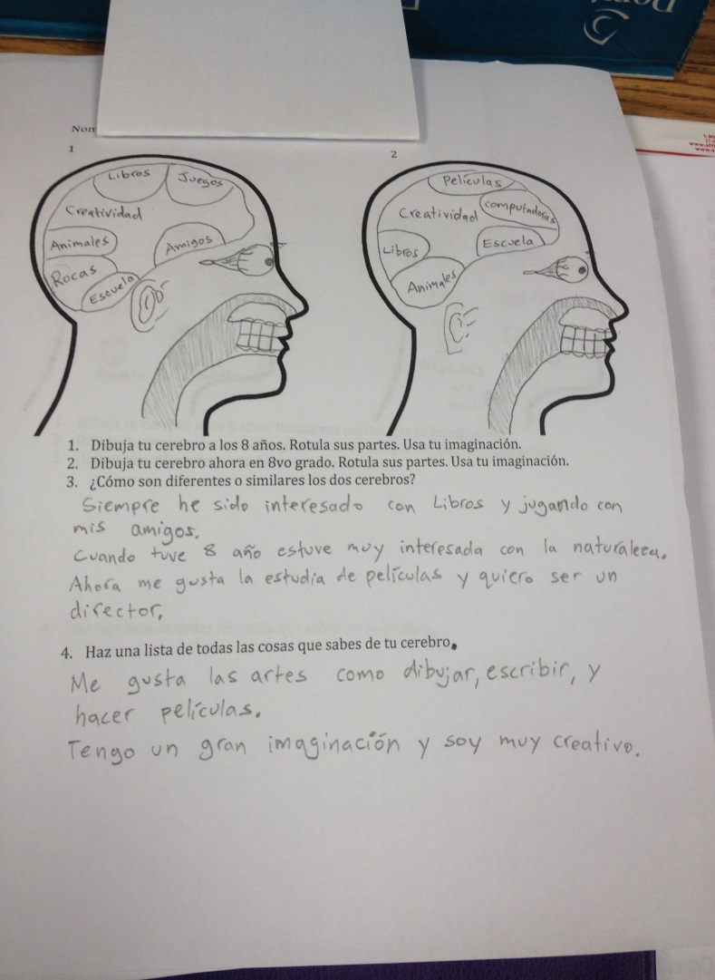
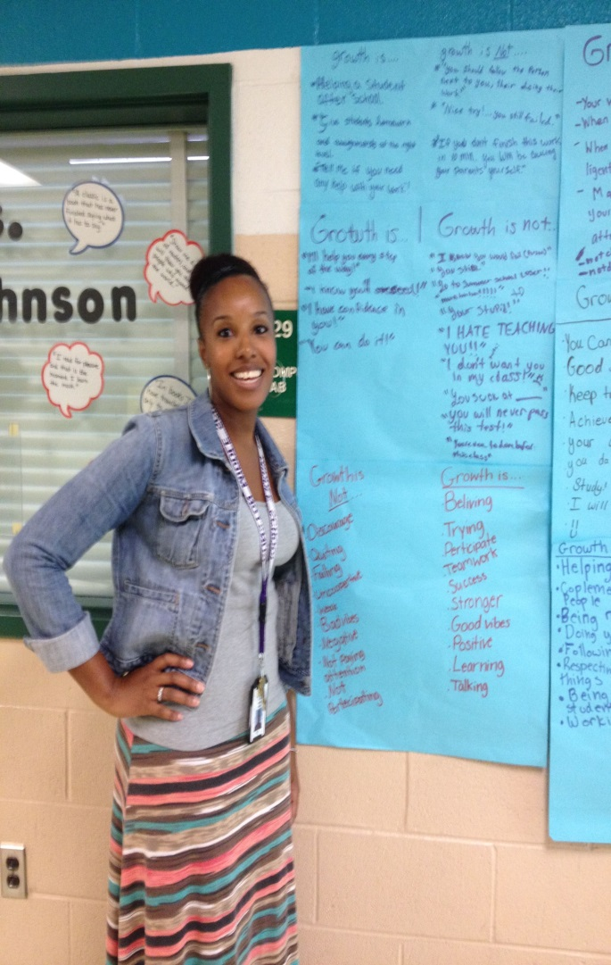
Planning with Teachers: Collaborative Book Studies
Mindset:
Increasing Capacity for Challenge:
Resilience & Autonomous Learners
Notes:
The following are examples to illustrate how RTGs work with collaboratively with teachers. Add specific examples from your school.

Slide 20
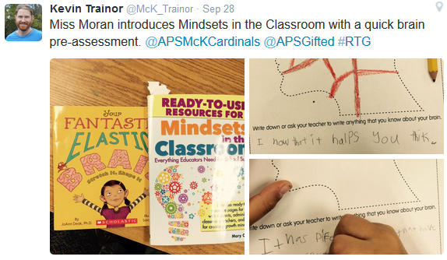
Planning with Teachers
Collaborative Book Studies: Mindset in the Classroom
Notes:
Collaborative Book Studies – Mindset – shows how PD with teachers impact classroom instruction
1st grade – pre assessment on brain and how it works

Slide 21
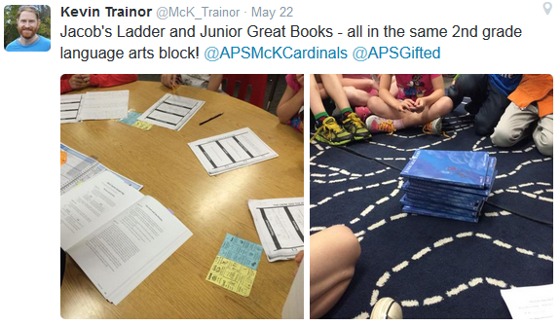
Modeling for Teachers
Curriculum for Advanced Learners:
Jacob’s Ladder & Levels of Questioning
Notes:
2nd grade

Slide 22
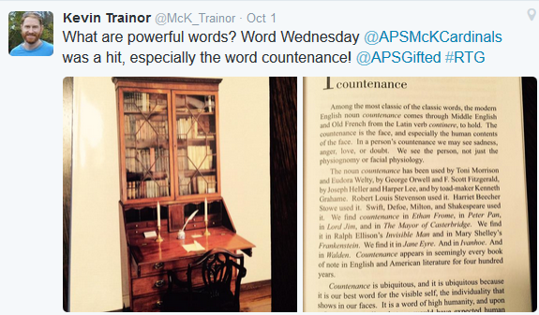
Supporting the Goals of Teachers
Planning for Vocabulary Development Aligned with
LA Standards

Slide 23
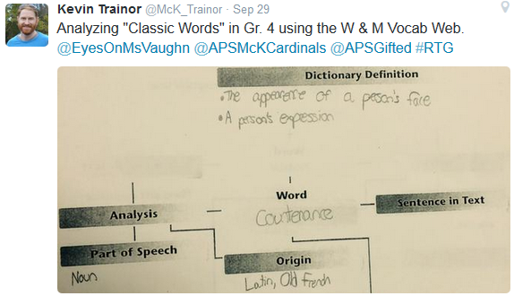
Parallel Teaching
William & Mary Teaching Model: Vocabulary Web
Notes:
Classic Words in Grade 4 using the W & M Vocabulary Web

Slide 24
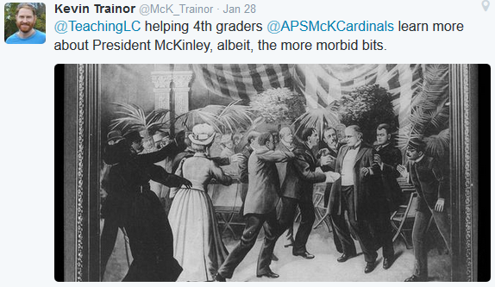
Connecting to Content
Advanced Content DBQs: Primary Source Analysis:
President McKinley
Notes:
President McKinley
Everything we do connects to standards and/or deepens understanding of standards and adds depth and complexity

Slide 25
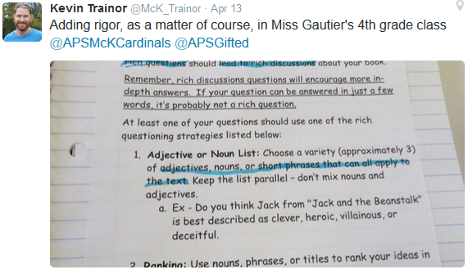
Collaborative Teaching
Advanced Content and Process:
Socratic Seminar
Notes:
4th grade Socratic Seminar

Slide 26
RTGs as Advocates for Historically Underserved Populations
Twice Exceptional (2e)
English Learners
High Ability, Low Income Students
Underachieving Students
Notes:
RTG advocates for underserved populations. The links are to the NAGC white papers. Also gives parents a resource to learn more about the research on different topics via NAGC

Slide 27
Arlington Tiered System of Support (ATSS)
ATSS is a system within collaborative learning teams (CLT) for meeting the needs of all students
Uses data to identify students who are in need of remediation or extensions
PLC question #4: How will we extend learning when they already know it or learn it quickly?
Notes:
ATSS is APS’s version of RTI (response to intervention)
While it was created to support students with special education needs in terms of their access to content, APS has created a system for meeting the needs of all students using data to identify students who need remediation and those who need more depth and complexity in their assignments

Slide 28
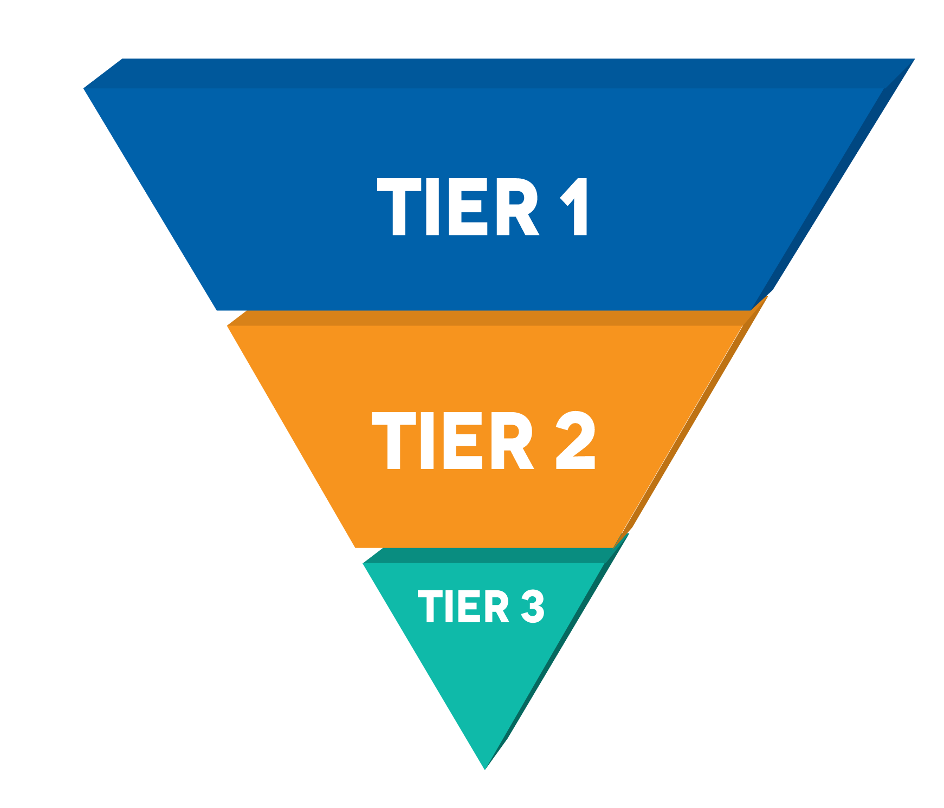
About ATSS
helps each student reach success in academics, behavior and social emotional well-being through a systemwide framework that provides additional resources and supports.
There are three tiers of instruction and support: Tier 1 (Core), Tier 2, and Tier 3.
Questions that guide each team:
What do we expect the
student to know or be able to do?
How do we know the
student has learned it?
What do we do if the
student has not learned it?
What do we do if
the student knows it?
Notes:
What is ATSS?
A framework to use multiple forms of data to identify early on which students need additional support or extension
ATSS includes a framework for providing additional support for academics, behavior and social emotional needs
ATSS is aligned to academic SOLs as well as standards and recommendations for Social Emotional learning (SEL) http://www.casel.org/social-and-emotional-learning/
Includes universal screeners and other forms of assessment
Shared ownership for all students
Data-driven with progress monitoring
Includes interventions, remediation, and extensions
Engages and involves families
ATSS is a general education initiative implemented within the general education system that coordinates services with special education, Title 1, ESOL, and Gifted
What ATSS is not~
A pre-referral system into special education
A program or a standalone period for intervention- it encompasses so much more
It is not only differentiation- ATSS goes beyond differentiation in classroom. It also includes keeping detailed data to monitor the progress of students who are struggling beyond what classroom differentiation can do. These interventions and resources go beyond the immediate classroom, such as reading specialists, cluster groups, gifted education services, and so on with on-going diagnostic and progress monitoring assessment than goes beyond classroom differentiation. Both Tier 2 and Tier 3 are more specialized levels of service that go beyond what we usually regard as differentiation such as wrap around services, counseling, and individualized or small group intervention/extension plans that are goal oriented and monitored weekly or bi weekly.
Tier 3 is not just for special education students or LEP students but the most intense level of support provided through general education. Some SWD/LEP certainly receive the supports at the Tier 3 level but they are also receiving special education services, related services, and ESOL services -meaning they are getting more than what is offered at the tier 3 level of general education.

Slide 29
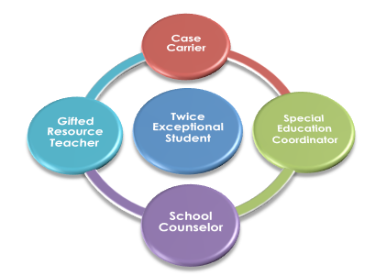
2e Wrap Around Support
Notes:
twice exception 2e students (504, ELL, Special Education ((SPED)) students) should be granted equitable access to rigorous classes should they meet the criteria and receive services and support as specified in their 504, English Language Learner (ELL), or Individualized Educational Plans (IEPs).
This vision shows the wrap around support that happens at the school level for 2e students.
More background for you:
Gifted Resource Teacher will check student schedule, advocate for student and ensure accommodations are being implemented in class; also sit on IEP and 504 teams
Special Education Coordinator will work with IEP team to monitor student progress and provide feedback to student’s team (counselor, gifted resource teacher, teacher, assistant principal);
Special Education Case Carrier will provide academic/behavioral updates to IEP team; assist in monitoring student progress and providing feedback to student’s team;
School Counselor will collaborate with gifted resource teacher, special education coordinator, special education case carrier, student and parents to monitor student progress, address student needs, and assess student progress; and
General Education Teacher will provide instruction and incorporate student accommodations as delineated in each student’s IEP. This teacher will contact parent to update student progress, assessment timelines, project deadlines and other course requirement details as needed.
If a student with a disability meets the criteria for gifted education services, the gifted identification and placement team determines the service options best suited to meet the student’s education needs. Educators of gifted learners should be involved in the development of the 2e student’s IEP, and must be informed of their specific responsibilities related to implementing the child’s IEP.
Just as it is important for the gifted education teacher to understand the characteristics of the 2e learner’s disability, it is important for the special education teacher to be aware of the characteristics of the 2e learner’s giftedness. There must be collaboration between the special education coordinator and carrier, counselor, gifted resource teacher and general education teacher to ensure that both areas of exceptionality are appropriately addressed; that there is consistency in the behavioral and academic expectations in all settings, and that the student’s strengths and interests are nurtured (Reis & Colbert, 2004).

Slide 30
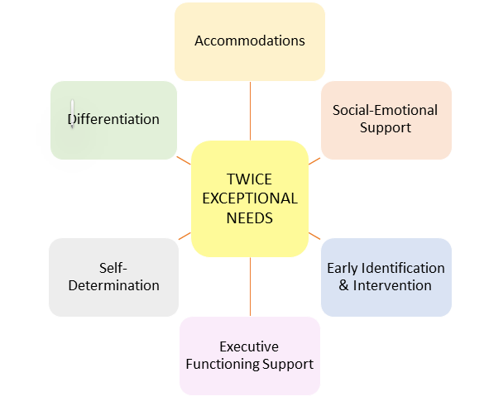
Notes:
Belief statements for each of these areas are on this link to support you with this graphic when you visit the website:
https://www.apsva.us/gifted-services/twice-exceptional/

Slide 31
2e at Our School
Examples of successful collaboration with teachers
Success story supporting a 2e learner
Structure of how teachers support students together at ______
Notes:
RTG adds specifics examples from here to show what it may look like

Slide 32
ESOL/HILT Support
Similar to 2e with wrap around support
RTG works collaboratively with general education teacher and ESOL/HILT teacher to find and nurture students
Building Background Knowledge
Access to Grade Level Content
Opportunities for Critical & Creative Thinking

Slide 33
ESOL/HILT at Our School
Examples of successful collaboration with teachers
Specific examples of how gifted services supported a HILT learner
Structure of how teachers support students together at
Notes:
RTG adds specifics to explain what this might look like in action

Slide 34
Ongoing Communication
Parent information night and identification power point on website
Collaborative effort between cluster teachers and RTGs
Ongoing communication in the form of CLT meetings, individual meetings, email, special project meetings
Each quarter grade level CLTs share information with the RTG about differentiated, expanded, and enriched curriculum in their subject area. The RTG compiles it into a chart to send to parents through school email.
Conference Days Can join cluster teacher for meetings
Other Meetings based on requests
Virginia Regulations 8 VAC20-40-40
Notes:
Here is where you can elaborate on how you will be communicating with parents.
This is your opportunity to share how you and the cluster teacher will have an ongoing dialogue with parents about how differentiation is happening
Does your principal do a newsletter each month? Does your PTA? Do you plan to do a monthly newsletter for parents highlighting what is happening? Could you share a strategy a month and how that is being implemented in different grade levels? And/or how advanced curriculum is being used in classrooms?
Do you have a Blackboard site? Padlet site? Do you add to grade level teams’ sites?
Do you have a listserv set up to communicate via email? Keep them informed about opportunities?
If so, add a bullet to this slide to reflect your plan here.
Differentiation Record Form – this is APS’s response to the Virginia Regulations saying that we need to report student assessment outcomes to parents. State regulation is below with wording for your background. As planning is ongoing with collaboration with the RTG, this differentiation form is a way to share this information in a consistent manner with parents.
8 VAC20-40-40
E. . . . Identified gifted students shall be offered placement in an instructional setting that provides:
1. Appropriately differentiated curriculum and instruction provided by professional instructional personnel trained to work with gifted students;
2. Monitored and assessed student outcomes that are reported to the parents and legal guardians.

Slide 35
Getting Connected: APS Gifted Services
Sign up for @APSGifted
Add your Twitter @
information & Schools Twitter information
@WilliamsburgAdmin
APS Gifted Services Website www.apsva.us/giftedservices
Notes:
ADD Your TWITTER handle
ADD your school graphic like the similar slide before moving on to ID process

Slide 36
Contact Information
David Steele, Resource Teacher for the Gifted
Email: david.steele@apsva.us
Phone: 703-228-6900
Cheryl McCullough, Supervisor, Gifted Services
Email: cheryl.mccullough@apsva.us
Phone: 703-228-6159
Notes:
Add your contact information here
Add your school logo by your name

Slide 37
Gifted Services Advisory Committee (GSAC)
Arlington Public School’s Parent Advocacy Group
Part of Advisory Council of Instruction https://www.apsva.us/aci/gifted-services/
Monthly meetings (1st Wednesday: 6:30 – 8:00 PM followed by ACI meeting 8:00 - 9:00 PM)
If interested in serving on this committee, please contact Dan Corcoran, danjcorcoraniii@gmail.com

Slide 38
Parent Resources
Virginia Association for the Gifted (VAG)
http://www.vagifted.org
National Association for the Gifted (NAGC)
http://nagc.org
Supporting Emotional Needs of the Gifted (SENG)
http://sengifted.org
Notes:
Here are a few organizations that support gifted education at the state and national level

Slide 39
Questions
?
?
Notes:
That was a quick overview of the services. Depending on your time allotted for your parent information night, gauge how much time you have for questions especially if you are doing this before a PTA meeting.
If you have time for questions, ask for questions that would be more generic in nature and ask that they write questions about their individual child on the index card so that you can respond one on one.
Also, gauge it based on whether or not you are doing the ID process now or will wait until January.
If you do not have time, stress that they have index cards for their questions and that you will get back to them
If you are doing the ID process now, you can invite the parents of the already ID ed students to leave if they would like to do so since they do not need this information about the ID process.

Slide 40
Part 3: The Gifted Identification Process

Slide 41
Gifted Services: Areas of Identification
Specific Academic Aptitude (Grades K-12)
English
Mathematics
Science
Social Studies
Visual or Performing Arts (Grades 3-12)
Visual Art
Vocal Music
Instrumental Music (instruments taught in APS)
Notes:
In following the regulations, students can be identified for Academic areas in grades K-12 & in Visual and Performing Arts in grades 3 – 12

Slide 42
Screening for Gifted Services
Each year, the total population is screened by school staff to create a pool of candidates based on students’ need for gifted services.
Students may be referred for services by their classroom teacher, school personnel, parents/guardians, community leaders, or other students until April 1st of the current school year
Once a student is referred for services, the RTG works to create a portfolio with four main components for a holistic case study approach.
Notes:
Students are considered for gifted services on a yearly basis.
Anyone who knows the child can submit a referral for gifted services. (For fall referrals, please know that there is a 90 instructional day process to allow for teachers to get to know your child as a learner and for the school to gather supporting information for the screening portfolio.
If teachers see a need for challenge, depth and complexity, they do not need a formal identification to adjust curricular content for students so while the bulk of screening happens in the winter/spring, it is an expectation that all APS teachers are differentiating and adjusting their teaching based on student needs.

Slide 43
1. Nationally-normed assessments
Grade 2 students, and new-to-APS 3rd graders, take the Naglieri Nonverbal Ability Test (NNAT-2)
Grade 4 students, and new-to-APS 5th graders, take the Cognitive Abilities Test (CogAT)
Other tests may be included such as the WISC, Kaufman-Brief Intelligence Test (KBIT)
Notes:
The state regulations calls for a mass screening at least once in a student’s educational career to help us find students who may not be demonstrating high performance in the classroom for a variety of reasons. APS added a mass screening tool in 2nd grade with the NNAT-2. This is a test of general intellectual ability in a non-verbal format. This test was selected as a way to cast a net for students who may not be “school smart” but who have the ability to think and problem solve at a higher level. This is what school systems use nationally to try to find historically underrepresented gifted learners because it is a culturally unbiased instrument and helps to find students from poverty, 2e learners and ELLs
In 4th grade all students are given the CogAT. This too is an ability test to measure potential as well as achievement as it does have verbal and mathematical items as part of the test.
In K-2, if a student is referred the RTG administers the K-BIT which is an individualized ability test. There is also an option of giving the NNAT-2 for K-2 students.
Other testing done by the school system is also reviewed to get a holistic picture of the child’s strengths
Parents may submit other testing done in other school districts or previously testing given by a private psychologist

Slide 44
2. School-based Achievement
County Level: SOLs, Interactive Achievement Tests and SRI
School Level: Ongoing formative and summative assessments
Individual Level: Honors or distinctions (ex. VJAS, History Day, Continental Math League, Reflections Contest, etc).

Slide 45
3. Student Behaviors/Characteristics
Local screening committee completes a Gifted Behavior Commentary (GBC)
Documents gifted characteristics and behaviors observed in a variety of settings across four categories
Parent Information Sheet
Documents gifted characteristics and behaviors observed in a variety of settings across four categories
Provides an opportunity for parents to share examples that the school team may not have had an opportunity to observe during the school day
Notes:
Local school committee meets and completes a Gifted Behavior Commentary Form on each student referred for gifted services
Team documents observed behaviors and characters in a variety of settings across four major areas
Parents may also submit a parent information form similar to the GBC to document characteristics and behaviors observed. I usually say that parents know their child best and this is an opportunity to give examples that the school may not have an opportunity to see during the school day

Slide 46
Gifted Behaviors Commentary (GBC)
Exceptional ability to learn
Is highly reflective and/or sensitive to his/her environment
Readily learns and adapts to new cultures
Is acquiring language at a rapid pace
Exceptional application of knowledge
Uses and interprets advanced symbol systems in academics, visual arts, and/or performing arts
Acts as an interpreter and/or facilitator to help others
Communicates learned concepts through role playing and/or detailed artwork
Exceptional creative / productive thinking
Expresses ideas, feelings, experiences, and/or beliefs in original ways
Perceives and manipulates patterns, colors, and/or symbols
Exceptional motivation to succeed
Meets exceptional personal and/or academic challenges
Exhibits a strong sense of loyalty and responsibility
Demonstrates exceptional ability to adapt to new experiences
Notes:
Here are the four categories for the GBC and the Parent Information Form
We have descriptors to support the school team in their creation of the GBC. These descriptors help us to capture a broader group of students in gifted services that will match the diverse background of students we have in APS and in each individual school

Slide 47
4. Demonstrated Performance
Distinguished levels of performances when working with advanced content.
Examples may include:
Interpretive responses within William and Mary Language Arts units
Analysis of Primary Source Documents – DBQs
Responses to Experimental Design lessons
Responses to Critical and Creative Thinking lessons
Notes:
Student work samples are collected over time to show critical and creative thinking and responses to advanced curriculum within content areas. Work samples are also collected to show growth over time beyond what is measured typically in grade level content
RTGs work with classroom teachers to develop this portfolio

Slide 48
Visual and Performing Arts
(VPA)
Referrals for Visual/Performing Arts begin in Grade 3
Gifted Behavior Commentary (Art and Music Teacher Observations of Artistic Behaviors)
Student Products provided by art/music teachers
Parent Information Form
Notes:
Switching gears a bit, RTGs also lead the screening and ID process for the Visual and Performing Arts.
Students may be referred starting in grade 3. Anyone who knows the child may refer him/her for gifted services. Like the academic referrals, the bulk of this work happens in winter and spring. If you refer your child in the fall, there is 90 day instructional day process to allow for teachers to get to know your child and develop a portfolio of work to support the process.
Again like the academic referrals, teachers do not have to wait for an official ID to provide depth and complexity for students who demonstrate a need for this level of differentiation.

Slide 49
Art Differentiation
Visual Arts:
Differentiation takes place in the art classes
analyzing their work with more in-depth questions
working with more/different materials
Open-ended projects that allow for students to demonstrate their creativity and abilities
Notes:
Once identified in art, differentiation happens within the art class.

Slide 50
Music Differentiation
Music:
Differentiation takes place in the music classes
Open-ended projects that allow for students to demonstrate their creativity and abilities
Additional Opportunities https://www.apsva.us/arts-education-overview/honors-band-orchestra-and-chorus/
Junior Honors Orchestra (grades 4 – 6) & Honors Orchestra (grades 7-8)
Elementary Honors Chorus (Grade 5) & Honors Chorus (grades 6-8)
Junior Honors Band (grades 4 – 6) & Honors Band (grades 7-8)
Honors Band
Honors Orchestra
Notes:
Once identified in music, differentiation happens within the music classroom.

Slide 51
Identification Decisions
At the end of the referral process (90 instructional days), a local screening committee meets to review the student’s portfolio and make determines about eligibility.
Identification decisions are sent to parents or guardians by letter within 10 school days of the Identification Committee meeting.
Gifted Services Identification Process Outlined on APS Gifted Services web page

Slide 52
If students are found eligible
Identified gifted students in grades 2-5 are cluster grouped* into classrooms with intellectual peers
RTG plans with and supports the classroom teachers using extension activities and projects for students who have already mastered grade-level content
Note: Support may look different in the various grade levels depending on teacher and student needs
*typically or the upcoming school year
Notes:
Again, access to advanced curriculum/critical and creative thinking skills does not have to wait for the ID.

Slide 53
If students are not found eligible
An appeal is available to families following the eligibility process
Appeals begin at the school level with the principal
A second level of appeal is countywide Gifted Services Administrative Appeals Committee
Notes:
Details for each step are shared in the ineligibility letter that is sent to parents. It can also be found on the APS Gifted Services webpage

Slide 54
Gifted Services Advisory Committee (GSAC)
Arlington Public School’s Parent Advocacy Group
Part of Advisory Council of Instruction https://www.apsva.us/aci/gifted-services/
Monthly meetings (1st Wednesday: 6:30 – 8:00 PM followed by ACI meeting 8:00 - 9:00 PM)
If interested in serving on this committee, please contact Dan Corcoran, danjcorcoraniii@gmail.com

Slide 55
Parent Resources
Virginia Association for the Gifted (VAG)
http://www.vagifted.org
National Association for the Gifted (NAGC)
http://nagc.org
Supporting Emotional Needs of the Gifted (SENG)
http://sengifted.org

Slide 56
Getting Connected: APS Gifted Services
Sign up for @APSGifted
@ RTG Twitter account and School Twitter account
@WilliamsburgAdmin
APS Gifted Services Website www.apsva.us/giftedservices
Notes:
ADD Your TWITTER handle
ADD your school graphic like the similar slide before moving on to ID process

Slide 57
Contact Information
_____________, Resource Teacher for the Gifted
Email:
Phone:
Cheryl McCullough, Supervisor, Gifted Services
Email: cheryl.mccullough@apsva.us
Phone: 703-228-6159
Notes:
Add your contact information here
Add your school logo by your name

Slide 58
Questions
?
?
Notes:
That was a quick overview of the the ID process. Depending on your time allotted for your parent information night, gauge how much time you have for questions especially if you are doing this before a PTA meeting.
If you have time for questions, ask for questions that would be more generic in nature and ask that they write questions about their individual child on the index card so that you can respond one on one.
If you are planning to have another ID meeting in January you can tell them this too.
If you do not have time, stress that they have index cards for their questions and that you will get back to them
If you are doing the ID process now, you can invite the parents of the already ID ed students to leave if they would like to do so since they do not need this information about the ID process.

